Slide 1
Mathematical Preliminaries – II
(Basic Probability - II)
Lecture 2
Part 3
Generative AI for Computer Vision

Slide 2
Outline
Joint Probability Distribution
Correlation and Covariance
Maximum Likelihood Estimation
Bayesian Learning

Slide 3
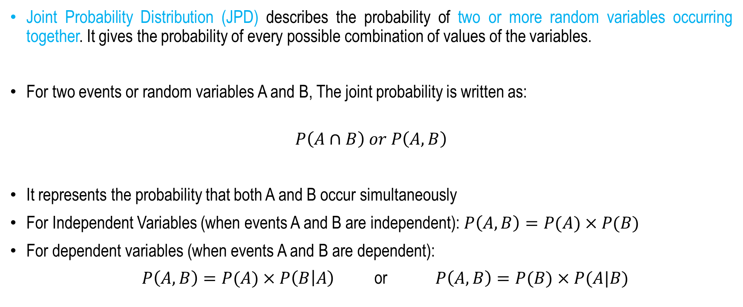
Joint Probability Distribution
Joint Probability Distribution (JPD) describes the probability of two or more random variables occurring together. It gives the probability of every possible combination of values of the variables.
For two events or random variables A and B, The joint probability is written as:
$$P\left(A∩B\right) or P\left(A,B\right)$$
It represents the probability that both A and B occur simultaneously
For Independent Variables (when events A and B are independent): $P\left(A,B\right)=P(A)×P(B)$
For dependent variables (when events A and B are dependent):
$P\left(A,B\right)=P(A)×P\left(B | A\right)$ or $P\left(A,B\right)=P(B)×P(A|B)$

Slide 4
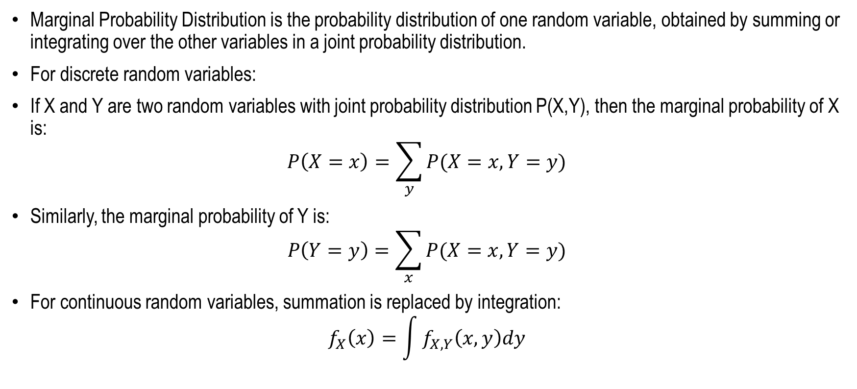
Marginal Probability Distribution
Marginal Probability Distribution is the probability distribution of one random variable, obtained by summing or integrating over the other variables in a joint probability distribution.
For discrete random variables:
If X and Y are two random variables with joint probability distribution P(X,Y), then the marginal probability of X is:
$$P\left(X=x\right)=\sum_{y}{P(X=x,Y=y)}$$
Similarly, the marginal probability of Y is:
$$P\left(Y=y\right)=\sum_{x}{P(X=x,Y=y)}$$
For continuous random variables, summation is replaced by integration:
$$f_{X}\left(x\right)=\int{f_{X,Y}\left(x,y\right)dy}$$

Slide 5
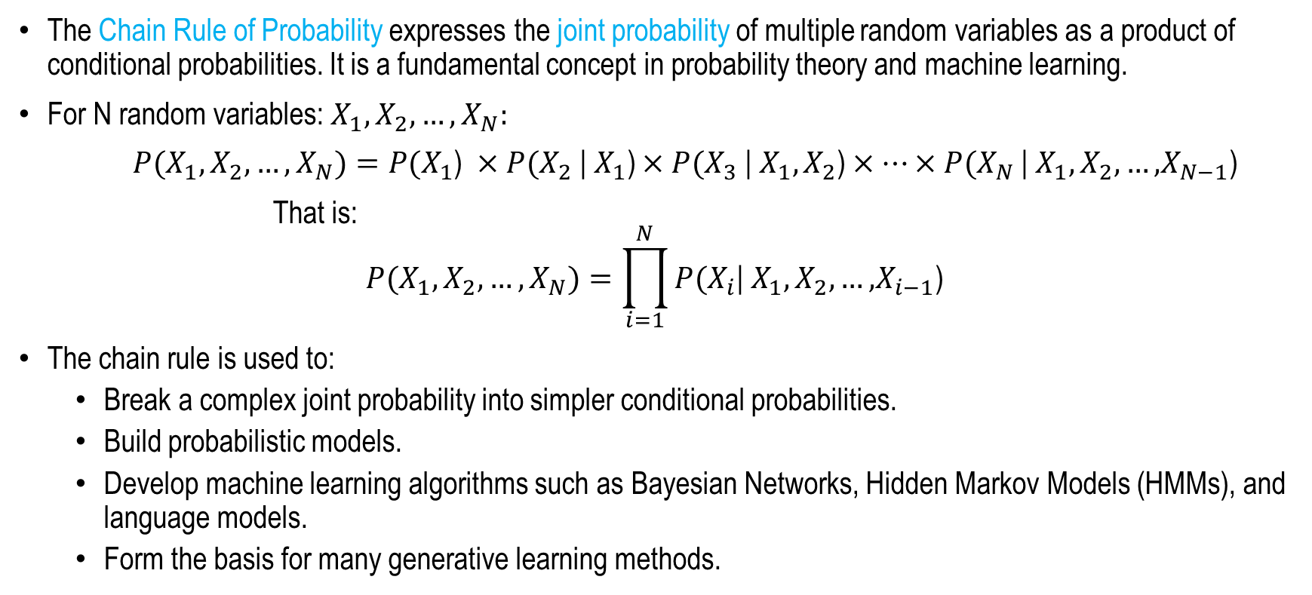
Chain Rule
The Chain Rule of Probability expresses the joint probability of multiple random variables as a product of conditional probabilities. It is a fundamental concept in probability theory and machine learning.
For N random variables: $X_{1},X_{2}, …, X_{N}:$
${P(X}_{1},X_{2}, …, X_{N})={P(X}_{1}$) ${×P(X}_{2}\text{|} X_{1}\text{)}{×P(X}_{3}\text{|} {X_{1},X}_{2}\text{)}×…{×P(X}_{N}\text{|} {X_{1},X}_{2}\text{,}…\text{,}X_{N−1}\text{)}$
That is:
$${P(X}_{1},X_{2}, …, X_{N})=\prod_{i=1}^{N}{{P(X}_{i}\text{|} {X_{1},X}_{2}\text{,}…\text{,}X_{i−1}\text{) }}$$
The chain rule is used to:
  Break a complex joint probability into simpler conditional probabilities.
  Build probabilistic models.
  Develop machine learning algorithms such as Bayesian Networks, Hidden Markov Models (HMMs), and language models.
  Form the basis for many generative learning methods.

Slide 6
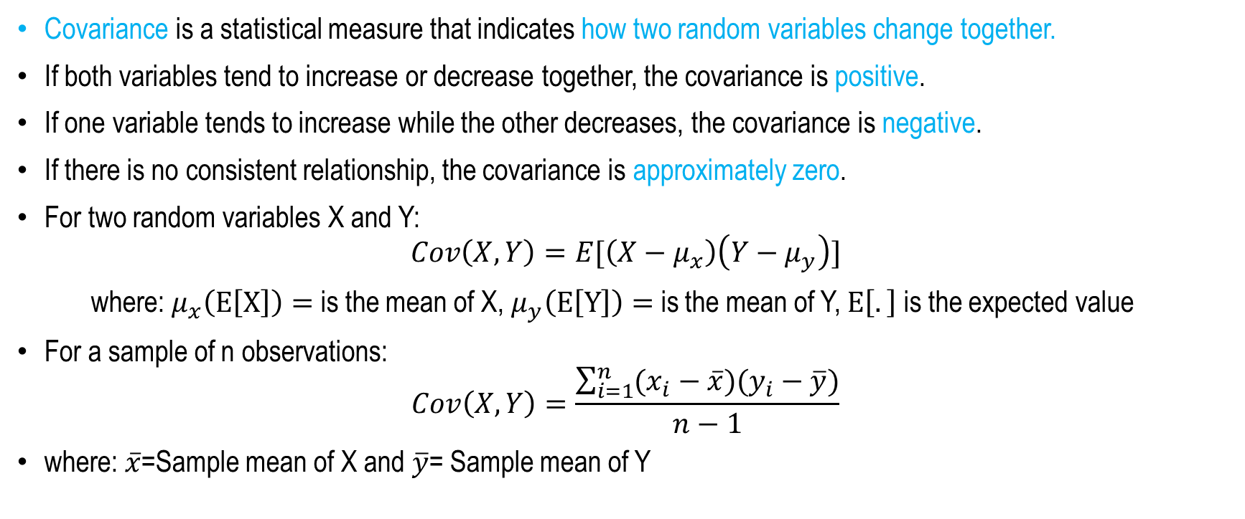
Covariance
Covariance is a statistical measure that indicates how two random variables change together.
If both variables tend to increase or decrease together, the covariance is positive.
If one variable tends to increase while the other decreases, the covariance is negative.
If there is no consistent relationship, the covariance is approximately zero.
For two random variables X and Y:
$$Cov\left(X,Y\right)=E[\left(X−μ_{x}\right)\left(Y−μ_{y}\right)]$$
where: $μ_{x}\left(E\left[X\right]\right)=$ is the mean of X, $μ_{y}\left(E\left[Y\right]\right)=$ is the mean of Y, $E\left[.\right]$ is the expected value
For a sample of n observations:
$$Cov\left(X,Y\right)=\frac{\sum_{i=1}^{n}{(x_{i}−\overline{x})(y_{i}−\overline{y})}}{n−1}$$
where: $\overline{x}$=Sample mean of X and $\overline{y}$= Sample mean of Y

Slide 7
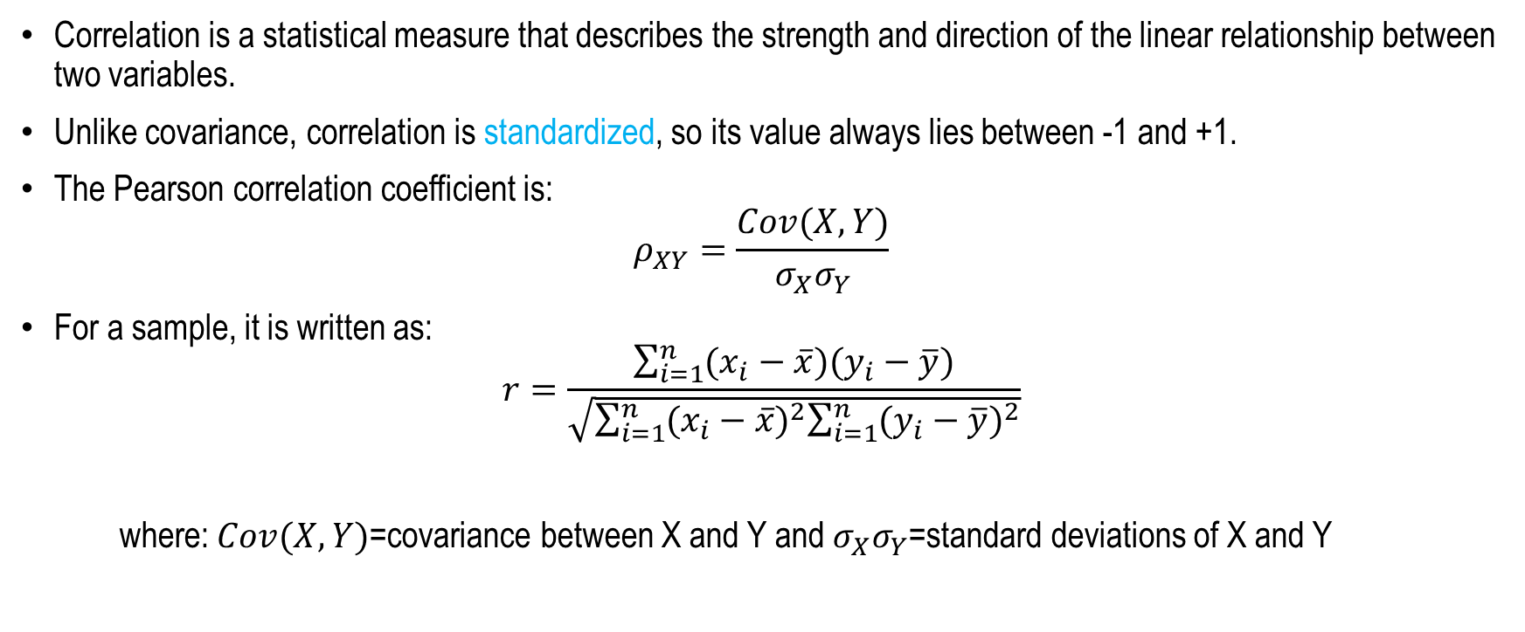
Correlations
Correlation is a statistical measure that describes the strength and direction of the linear relationship between two variables.
Unlike covariance, correlation is standardized, so its value always lies between -1 and +1.
The Pearson correlation coefficient is:
$$ρ_{XY}=\frac{Cov(X,Y)}{σ_{X}σ_{Y}}$$
For a sample, it is written as:
$$r=\frac{\sum_{i=1}^{n}{(x_{i}−\overline{x})(y_{i}−\overline{y})}}{\sqrt{\sum_{i=1}^{n}{{(x_{i}−\overline{x})}^{2}\sum_{i=1}^{n}{{(y_{i}−\overline{y})}^{2}}}}}$$
where: $Cov(X,Y)$=covariance between X and Y and $σ_{X}σ_{Y}$=standard deviations of X and Y

Slide 8
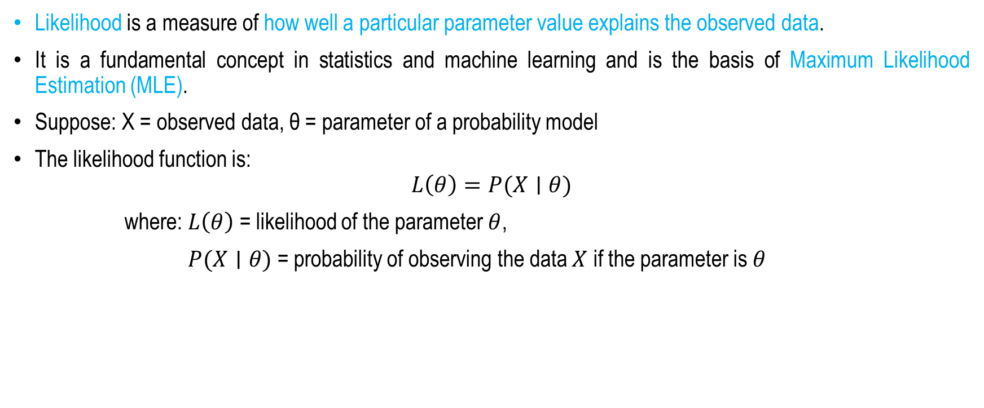
Likelihood
Likelihood is a measure of how well a particular parameter value explains the observed data.
It is a fundamental concept in statistics and machine learning and is the basis of Maximum Likelihood Estimation (MLE).
Suppose: X = observed data, θ = parameter of a probability model
The likelihood function is:
$$L\left(θ\right)=P(X∣θ)$$
where: $L\left(θ\right)$ = likelihood of the parameter $θ$,
$P(X∣θ)$ = probability of observing the data $X$ if the parameter is $θ$

Slide 9
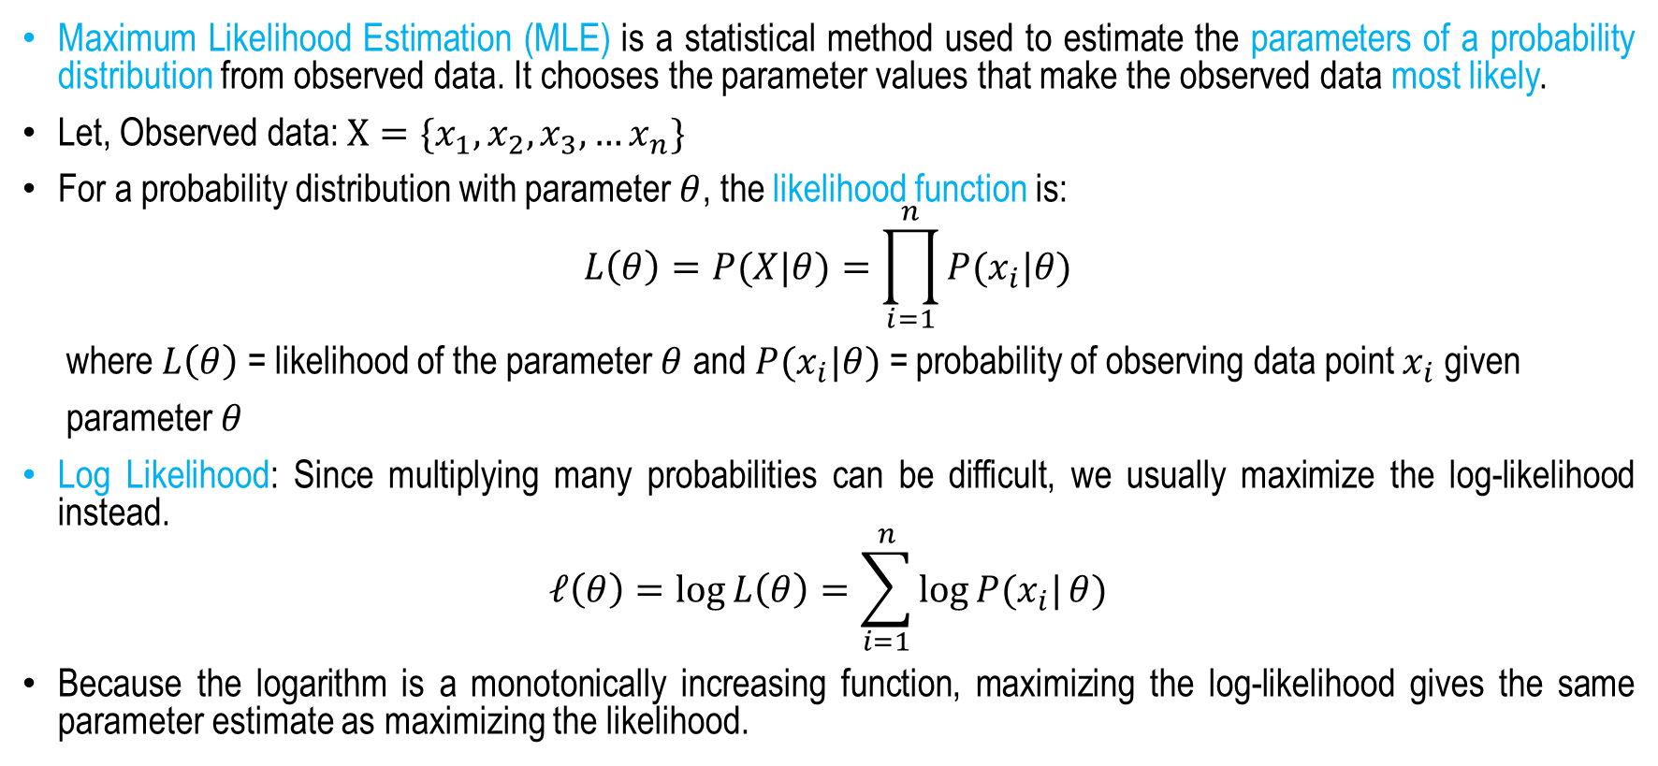
Maximum Likelihood Estimation (MLE)
Maximum Likelihood Estimation (MLE) is a statistical method used to estimate the parameters of a probability distribution from observed data. It chooses the parameter values that make the observed data most likely.
Let, Observed data: $X=\{x_{1},x_{2},x_{3},…x_{n}\}$
For a probability distribution with parameter $θ$, the likelihood function is:
$$L\left(θ\right)=P(X|θ)=\prod_{i=1}^{n}{P(x_{i}|θ)}$$
where $L\left(θ\right)$ = likelihood of the parameter $θ$ and $P(x_{i}|θ)$ = probability of observing data point $x_{i}$ given
parameter $θ$
Log Likelihood: Since multiplying many probabilities can be difficult, we usually maximize the log-likelihood instead.
$$𝓁\left(θ\right)=\log{L\left(θ\right)=\sum_{i=1}^{n}{\log{P(x_{i}|}}}θ)$$
Because the logarithm is a monotonically increasing function, maximizing the log-likelihood gives the same parameter estimate as maximizing the likelihood.

Slide 10
Bayes Theorem
the likelihood of that data being generated if hypothesis h is true
prior probability of hypothesis h
posterior probability
prior probability of training data D
P(h) = prior probability of hypothesis h or class prior probability
P(D) = prior probability of training data D or Predictor prior probability
P(h|D) = probability of h given D, it is called posterior probability
P(D|h) = probability of D given h, or If the hypothesis is true, what is the likelihood of that data being generated

Slide 11
Bayesian Learning
Can Bayes theorem be applied to find the suitable hypothesis?
Maximum a Posteriori (MAP) is a probabilistic framework that finds the most probable hypothesis that describes the training dataset.

Slide 12
Choosing Hypotheses
Generally want the most probable hypothesis given the training data Maximum a posteriori hypothesis h_{MAP}. In otherwords, the map hypothesis is given by that value of h for which probability h given data is maximized.
If for all hypothesis functions, P(h)s are equal, i.e. we assume P(h_{i})=P(h_{j}) then can further simplify, and choose the Maximum likelihood (ML) hypothesis
when the prior probability of the all hypothesis are equal.

Slide 13
Bayes Optimal Classifier
So far, we have studied several fundamental concepts in probabilistic machine learning.
Bayes' Theorem provides a principled framework for computing conditional probabilities by updating prior beliefs in light of new evidence, resulting in the posterior probability.
Building on this foundation, the Maximum a Posteriori (MAP) framework identifies the hypothesis that has the highest posterior probability given the training data, making it the most probable explanation for the observed dataset.
Extending this idea further, the Bayes Optimal Classifier considers the entire space of possible hypotheses and predicts the class label for a new data instance by combining their predictions according to their posterior probabilities.
As a result, it provides the theoretically optimal classification by minimizing the expected prediction error.

Slide 14
Difference between MAP and Bayes Optimal Classifier
MAP and MLE frameworks answer the following question:
  What is the most probable hypothesis given the training data?
Bayes optimal classifier answers
  What is the most probable classification of the new instance given the training data?
This is different from the MAP framework that seeks the most probable hypothesis (model). Instead, we are interested in making a specific prediction.
  In general, the most probable classification of the new instance is obtained by combining the predictions of all hypotheses, weighted by their posterior probabilities.

Slide 15
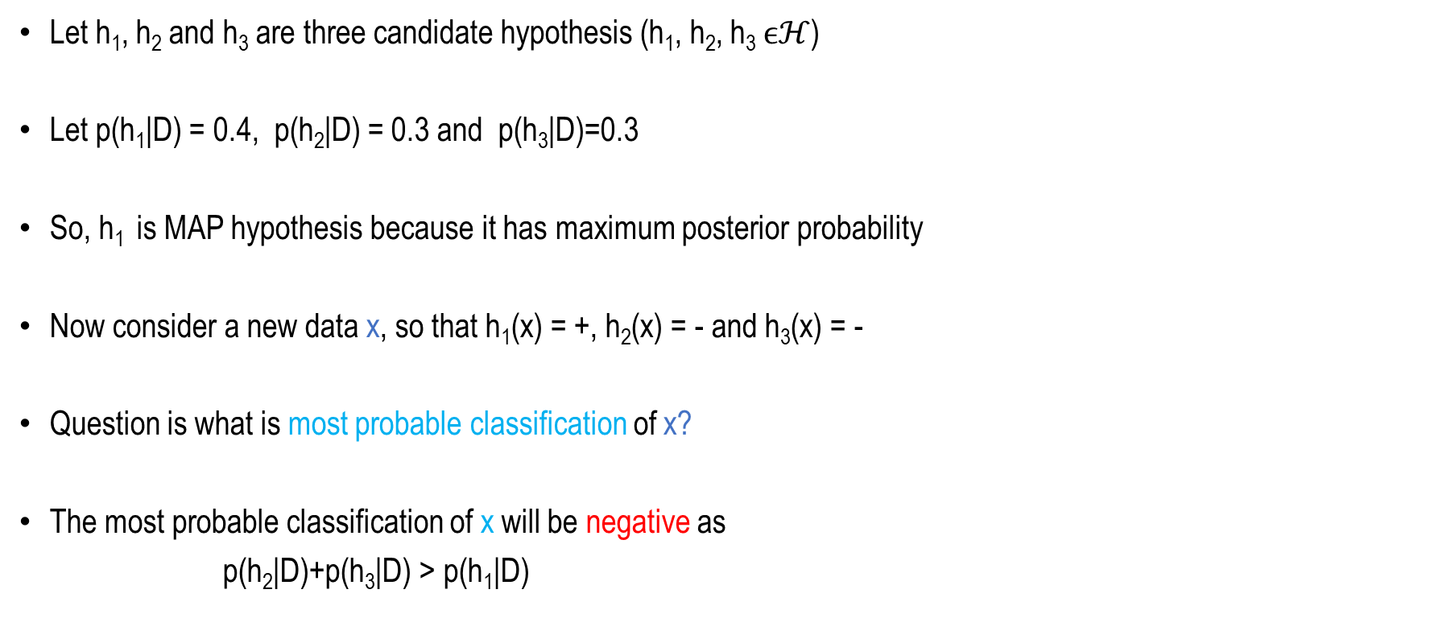
Example
Let h₁, h₂ and h₃ are three candidate hypothesis (h₁, h₂, h₃ $ϵℋ$)
Let p(h₁|D) = 0.4, p(h₂|D) = 0.3 and p(h₃|D)=0.3
So, h₁ is MAP hypothesis because it has maximum posterior probability
Now consider a new data x, so that h₁(x) = +, h₂(x) = - and h₃(x) = -
Question is what is most probable classification of x?
The most probable classification of x will be negative as
p(h₂|D)+p(h₃|D) > p(h₁|D)

Slide 16
Bayes Optimal Classifier
Bayes optimal classification
Example:
P(h₁|D)=.4, P(-|h₁)=0, P(+|h₁)=1
P(h₂|D)=.3, P(-|h₂)=1, P(+|h₂)=0
P(h₃|D)=.3, P(-|h₃)=1, P(+|h₃)=0
therefore
and
V = set of all possible classes

Slide 17
Summary
Joint Probability Distribution
Correlation and Covariance
Maximum Likelihood Estimation
Bayesian Learning

Slide 18
Neural Network Fundamentals
Next
Lecture 3
Generative AI for Computer Vision

